Slide 1
ISO 26000

Slide 2
What is ISO?
ISO (International Organization for Standardization) is the world’s largest developer of voluntary International Standards.
Founded in 1947, it has published more than 19 500 International Standards covering most aspects of technology and business.
ISO is also becoming increasingly active in the social sphere: ISO 26000, ISO work on Human Resources.

Slide 3
Development of ISO 26000
2001 Proposal by the ISO’s Committee on Consumer Policy (COPOLCO) for the drafting of an ISO standard on Social Responsibility.
2004 Decision by the ISO TMB for the development of an ISO SR Standard.
2005-2010 Development of ISO 26000 by more than 600 experts from 99 countries.
Sept. 2010 Vote on the draft ISO 26000.
Nov. 2010 Publication of ISO 26000.

Slide 4
Objectives of ISO 26000
to assist all kinds of organizations in contributing to sustainable development.
to encourage organizations to go beyond legal compliance, recognizing that compliance with law is a fundamental duty of any organization and an essential part of their social responsibility.
to promote common understanding in the field of social responsibility.
to complement other instruments and initiatives for social responsibility, not to replace them.
► Thus, ISO 26000 is a voluntary guidance standard!

Slide 5
What ISO 26000 is not!
  ISO 26000 is not a management system standard.
  It is not intended or appropriate for certification purposes or regulatory or contractual use.
  Any offer to certify, or claims to be certified, to ISO 26000 would be a misrepresentation of the intent and purpose and a misuse of ISO 26000.
  As ISO 26000 does not contain requirements, any such certification would not be a demonstration of conformity.

Slide 6
Why is ISO 26000 relevant for Business?
The fact that it was developed through a global consensus process has given ISO 26000 a high profile and attracted significant attention.
It is frequently listed together with the ILO Tripartite Declaration, the OECD Guidelines for Multinational Enterprises, the UN Guiding Principles on Business and Human Rights, and the UN Global Compact as one of the main international instruments to guide business on social responsibility.
Companies should be aware of ISO 26000 in order to respond to any potential requests from consumers, NGOs or customers.

Slide 7
Key Content of ISO 26000
Definition of key terms and the principles of SR (ch. 2 and 4).
Guidance on recognising SR and identify and engage the relevant stakeholder (ch. 5).
Core subjects of SR (ch. 6).
Recommendations on how to integrate SR into the organisation (ch. 7).

Slide 8
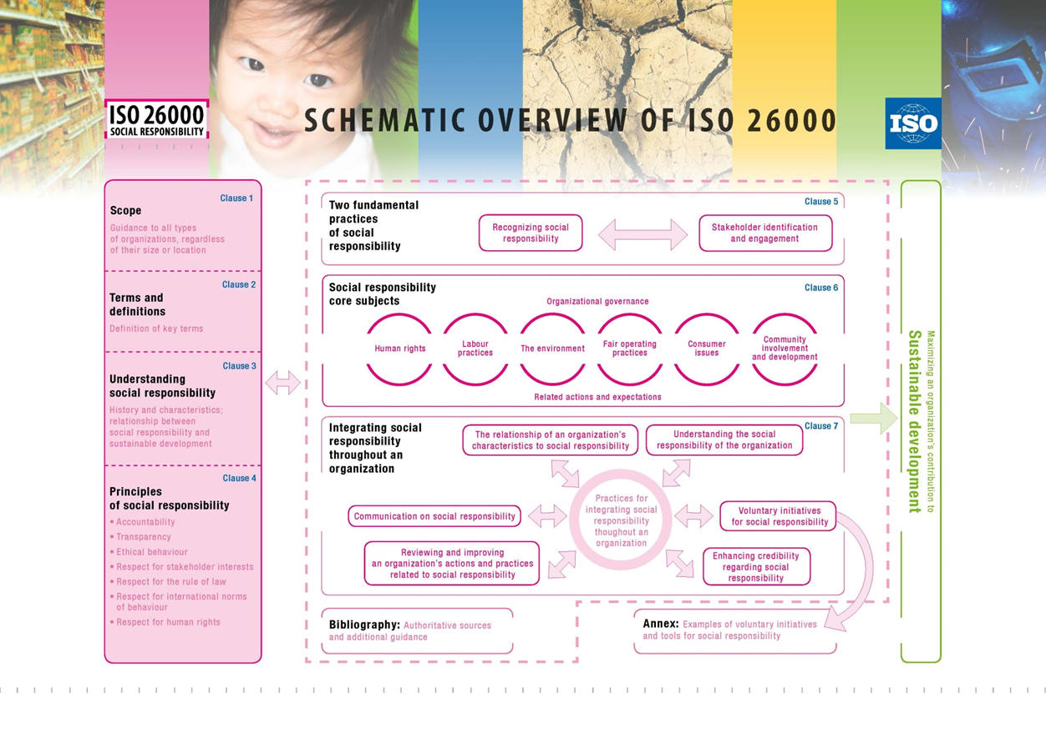

Slide 9
Seven Principles of social responsibility for organisations:
Accountability for impacts on society, the economy and the environment
Transparency in decisions and activities that impact on society and the environment
Ethical behaviour
Respect, consideration and responsiveness towards stakeholder interests
Respect for the rule of law
Respect for international norms of behaviour
Respect for human rights and recognition of their importance and universality

Slide 10
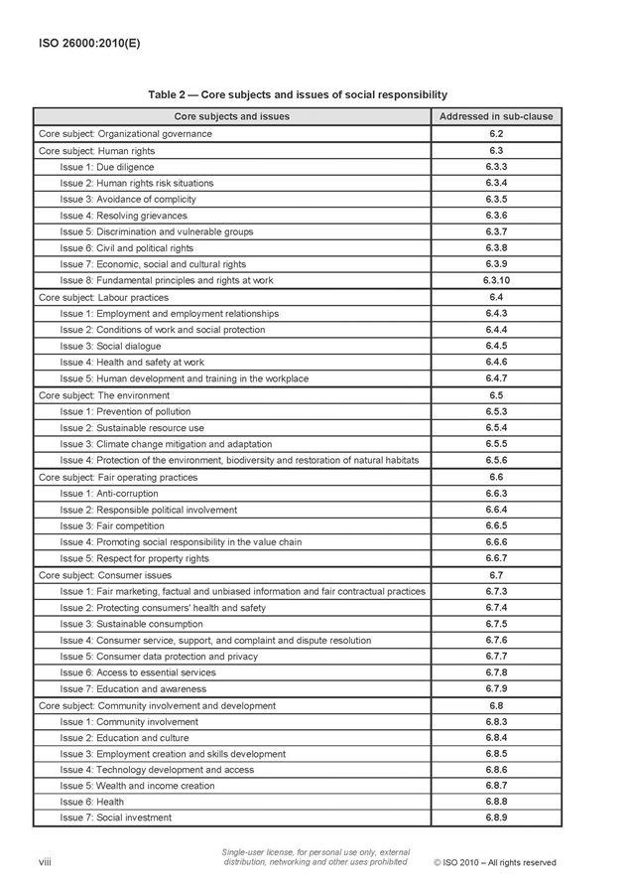

Slide 11
Core subjects
Review all the core subjects to identify which issues are relevant.
Assess the extent of the organization's impacts.
There are no concrete recommendations - ISO 26000 is not a check list.
Organisations have to identify themselves if and what kind of action is required.

Slide 12
Guidance on integrating social responsibility
Understanding the social responsibility of an organization through due diligence - identify the actual and potential negative social, environmental and economic impacts of an organization's decisions and activities, in order to avert and mitigate those impacts.
Determining relevance and extent of core subjects and issues.
Assessing an organization's sphere of influence and exercising influence.
Establishing priorities for addressing issues.
Raising awareness and building SR competency.

Slide 13
Building social responsibility into an organization's governance, systems and procedures.
Communicating on SR.
Resolving conflicts or disagreements between an organization and its stakeholders.
Reviewing and improving organization's actions and practices related to social responsibility.

Slide 14
What are the main strengths of ISO 26000?
It reflects broad international consensus on the elements of social responsibility, drawn from authoritative international instruments;
As such, it serves as a good basis for cross-border discussions on social responsibility;
It provides good orientation for starting a social responsibility journey;
It contains a good basis for engaging in stakeholder dialogue and other external discussions;
It allows for freedom of use: users may draw upon as much or as little of the guidance as necessary to help inform their own social responsibility policies or practices.

Slide 15
What are the main weaknesses of ISO 26000?
Unlike other international SR instruments, ISO 26000 is not available free of charge.
At 118 pages, it is long, complex and difficult to read.
Many elements of the guidance are oriented more toward larger organizations and will not be relevant for smaller or medium-sized organizations.
The guidance tends to dictate actions rather than to explain the benefits of SR and encourage action.
Even though ISO 26000 is explicitly not for certification, it has been misused by many certification services.

Slide 16
Current issues around ISO 26000
Since its launch the ISO 26000 discussion has been dominated by the issue of certification.
Some national certifiable standards based on ISO 26000 have been developed (Denmark, Spain).
There have also been efforts to develop ISO 26000 further at international level: proposal for the development of an ISO International Workshop Agreement on self‐declaring the application of ISO 26000 (July 2012).
A systematic review of ISO 26000 ended in March 2014: The majority of ISO member organisations want to keep ISO26000 as it stands.

